Slide 1

Coronavirus Disease(covid-19)Associated Mucormycosis
Submitted by-Sonal Saubhya
Admission No.-19SBAS1060020
B.Sc. Microbiology(semester5)
.
Under the supervision of
Dr.Rajesh Yadav
Assistant Professor
Department of Life Sciences
Division of Microbiology ,SBAS
Galgotias University

Slide 2
Insight About Mucormycosis Disease
Mucormycosis(previously called zygomycosis) is a serious but rare fungal infections caused by a group of molds called MUCORMYCETES.
These infections are usually acquired when spores from the mold are breathed in(inhaled) or less commonly,enter the body through a cut in the skin.These mold live throughout the environment.
Mucormycosis mainly affects people who have health problems or take medicine that lower the body’s ability to fight germs and sickness(Immunocompromised).
It most commonly affects the sinuses or the lungs after inhaling fungal spores from the air.It can also occur on the skin after a cut ,burn or other type of skin injury.

Slide 3

Mucormycosis-fungal disease
Small outbreaks or clusters of mucormycosis can occur in certain group of people ,such as those who have had an organ transplant .CDC(Centers for Disease Control and Prevention)usually investigates one to three of these clusters each year.
Rhizopus species,Mucor species,Rhizomucor species etc are types of fungi that most commonly cause mucormycosis.

Slide 4
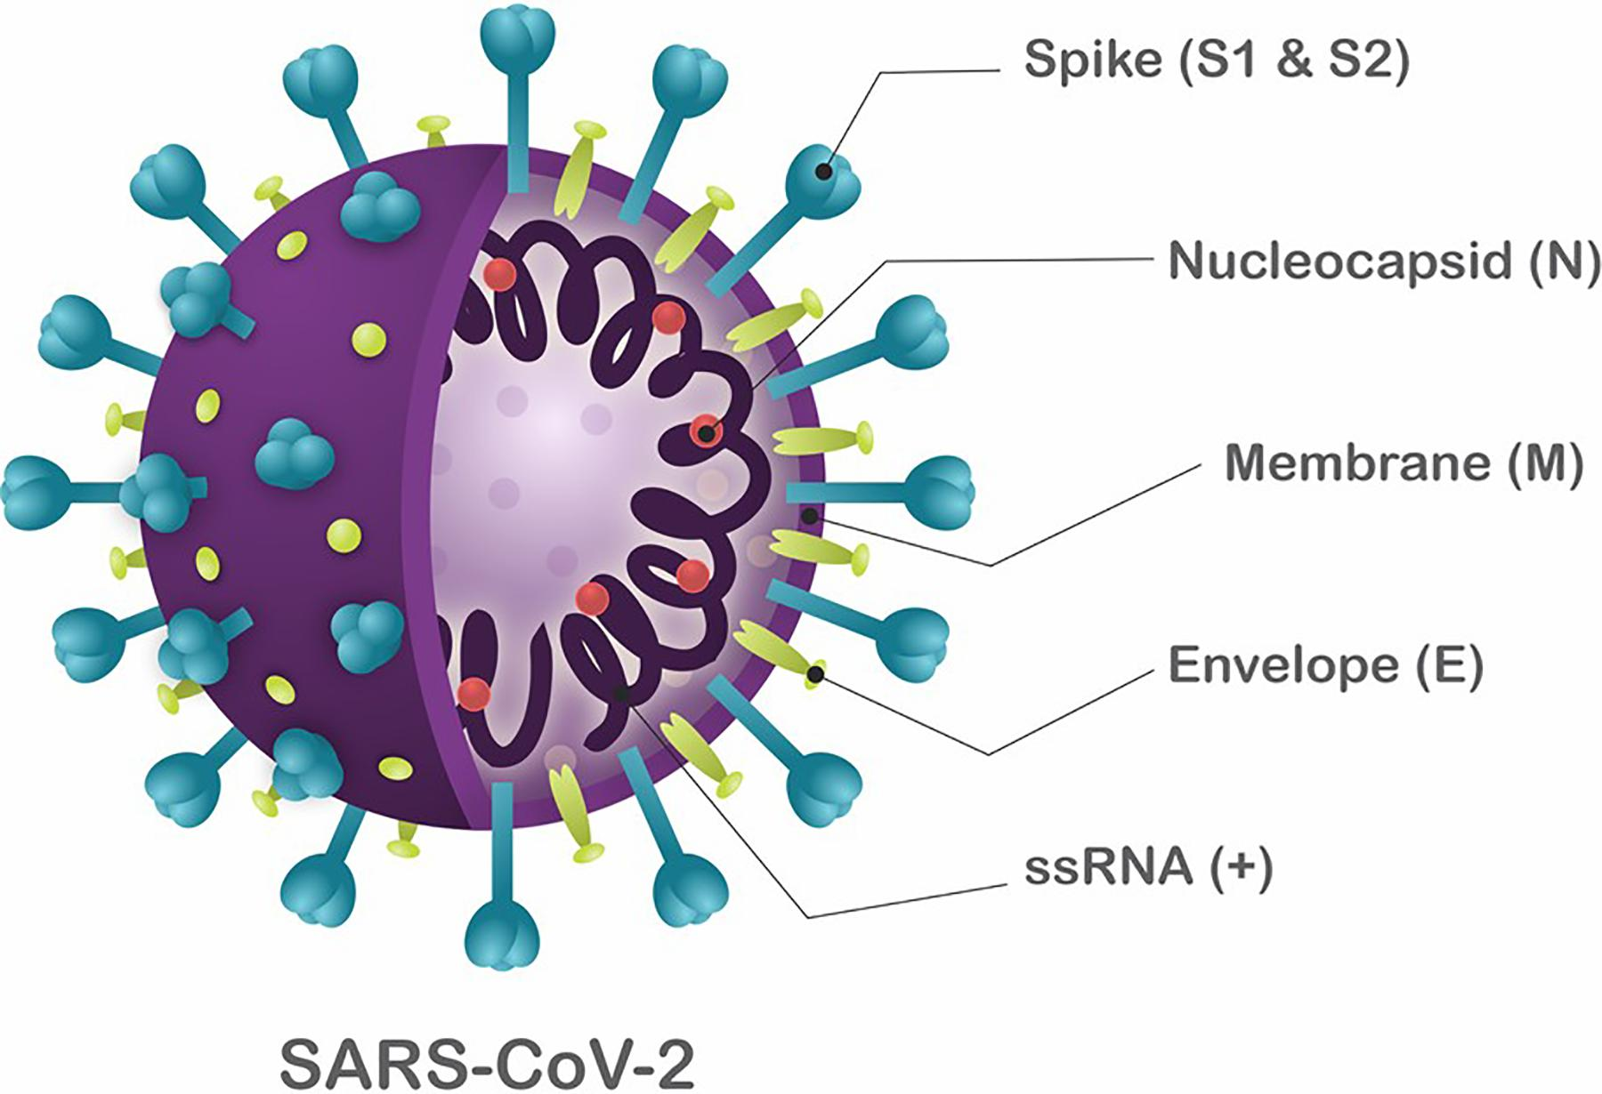
Insight About Coronavirus Disease (COVID-19)
Coronavirus (CoV) are a large family of viruses that cause illness ranging from the common cold to more severe disease.
A novel coronavirus (nCoV) is a new strain that has not been previously identified in humans.
It is caused by infection with the Severe acute respiratory syndrome coronavirus 2 (SARS-CoV-2) virus strain.

Slide 5

The outbreak of Novel Coronavirus Disease (COVID-19) was initially noticed in a seafood market in Wuhan city in Hubei province of china in mid-December ,2019,has now spread to 215 countries/territories/areas worldwide.

Slide 6
Introduction about CAM
The pandemic coronavirus disease 2019(COVID-19) continues to be a significant problem worldwide.
While several treatment options have been evaluated ,none except systemic GLUCOCORTICOIDS (medicine that fight imflammation and work with your immune system to treat wide range of health problem)have been shown to improve survival in COVID-19.
Unfortunately , the widespread use of Glucocorticoids can lead to secondary bacterial or fungal infections.
Invasive Pulmonary Aspergillosis complicating the course of COVID-19 is widely recognized;however,Mucormycosis is uncommonly suspected or diagnosed.

Slide 7
A case study of Pulmonary Mucormycosis in a patient with severe COVID-19
A case of probable pulmonary mucormycosis in a 55-year –old man with Diabetes ,end stage kidney disease ,and COVID-19.
The case was diagnosed with pulmonary mucormycosis 21 days following admission for severe COVID-19.
He recieved 5g of liposomal amphotericin B and was discharged after 54 days from the hospital.
They also performed a systematic review and identified seven additional cases of COVID-19 associated mucormycosis(CAM).

Slide 8
Of the eight cases included in their review, Diabetes Mellitus was the most common risk factor.
Three of them had no risk factor other than Glucocorticoids for COVID-19.
Mucormycosis usually developed 10-14 days after hospitalization .All except the above case died.
In two person ,CAM was diagnosed postmortem.Mucormycosis is an uncommon but serious infection that complicates the course of severe COVID-19.
Person with diabetes mellitus and multiple risk factors may be at a higher risk for developing mucormycosis.
Concurrent Glucocorticoids therapy probably heightens the risk of mucormycosis.

Slide 9
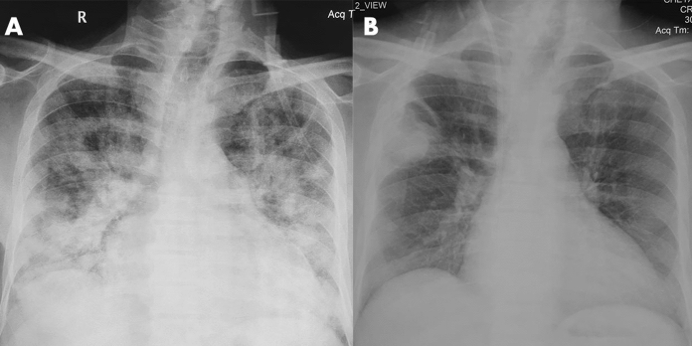
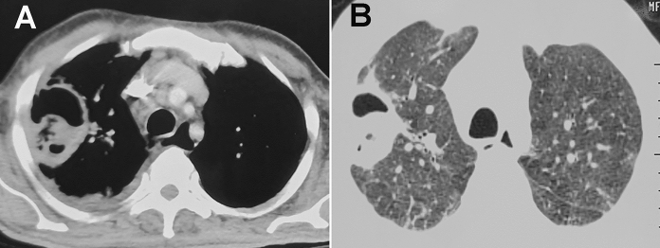
Fig:- Chest radiograph at admission a showing bilateral diffuse infiltrates and cardiomegaly .In the third week of hospitalization ,a cavity with intracavitary content b can be seen in the right upper zone .
Fig. 1 Chest radiograph at admission a showing bilateral diffuse infiltrates and cardiomegaly. In the third week of hospitalization, a cavity with intracavitary content b can be seen in the right upper zone
Fig. 1 Chest radiograph at admission a showing bilateral diffuse infiltrates and cardiomegaly. In the third week of hospitalization, a cavity with intrcontent b can be seen in the right upper zone
Fig:- Computed tomography showing thick-walled cavity in the night upper lobe in the corresponding mediastinal A and lung window B sections.

Slide 10
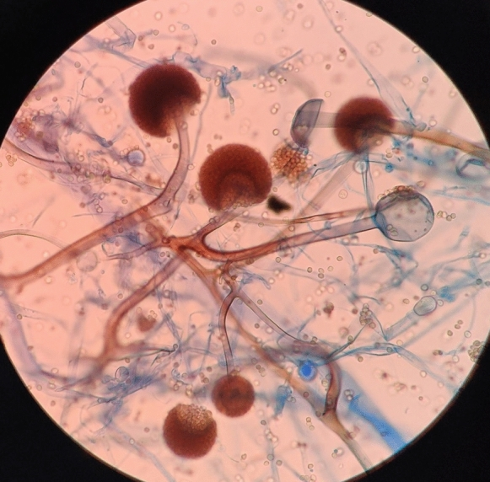
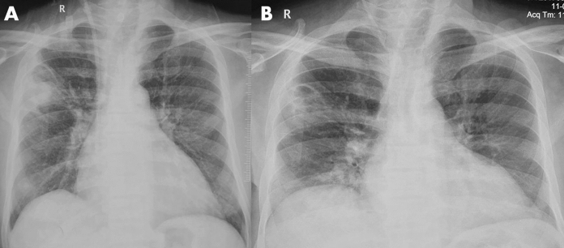
FIG:- Lactophenol cotton Blue(LCB) Mount from the growth revealed aseptate hyphae with nodal rhizoids and short sporangiophores with terminal spherical sporangia filled with brownish sporangiospores,suggestive of Rhizopus microspores.
FIG:- Chest radiograph performed at discharge A and after completing amphotericin therapy B showed significant resolution of the right upper zone cavityg. 1 Chest radiograph at admission a showing bilateral diffuse infiltrates and cardiomegaly. In the third week of hospitalization, a cavity with intracavitary content b can be seen in the right upper zone

Slide 11
Discussion:-
One alarming observation was the absence of traditional risk factors,such as diabetes mellitus ,transplantation ,or hematological malignancies,in three person with CAM.
The development of mucormycosis can probably be attributed to the use of Glucocorticoids and suggests a need for their use .
Thus,the use of Glucocorticoids in mild COVID-19 cases (without Hypoxemia-a low level of oxygen in blood ) or the utilization of higher doses of Glucocorticoids should be avoided .
Further,in the absence of a clear benefit ,drugs targeting immune pathways such as tocilizumab should be discouraged.

Slide 12
In summary ,physicians caring for critically ill COVID-19 patients must be aware of serious infections that can complicate the course of COVID-19.
A higher degree of clinical suspicion is required to diagnose pulmonary mucormycosis .
Early diagnosis and timely management are necessary to improve outcomes in pulmonary mucormycosis.

Slide 13
Reference:-
Arastehfar A, Carvalho A, van de Veerdonk FL, Jenks JD, Koehler P, Krause R, et al. COVID-19 associated pulmonary aspergillosis (CAPA)-from immunology to treatment. J Fungi (Basel). 2020;6(2):91. doi: 10.3390/jof6020091. - DOI - PMC - PubMed
Reference method for broth dilution antifungal susceptibility testing of filamentous fungi: approved standard-second edition. CLSI document M38-A2. Clinical and Laboratory Standards Institute, Wayne, PA: CLSI, 2008.
Group WHOREAfC-TW. Sterne JAC, Murthy S, Diaz JV, Slutsky AS, Villar J, et al. Association between administration of systemic corticosteroids and mortality among critically Ill patients with COVID-19 a meta-analysis. JAMA. 2020;324(13):1330–13341. doi: 10.1001/jama.2020.17023. - DOI - PMC - PubMed

Slide 14
Thank you

